Slide 1
Payment Processor Project

Slide 2
Question 1:
Merchant Types

Slide 3
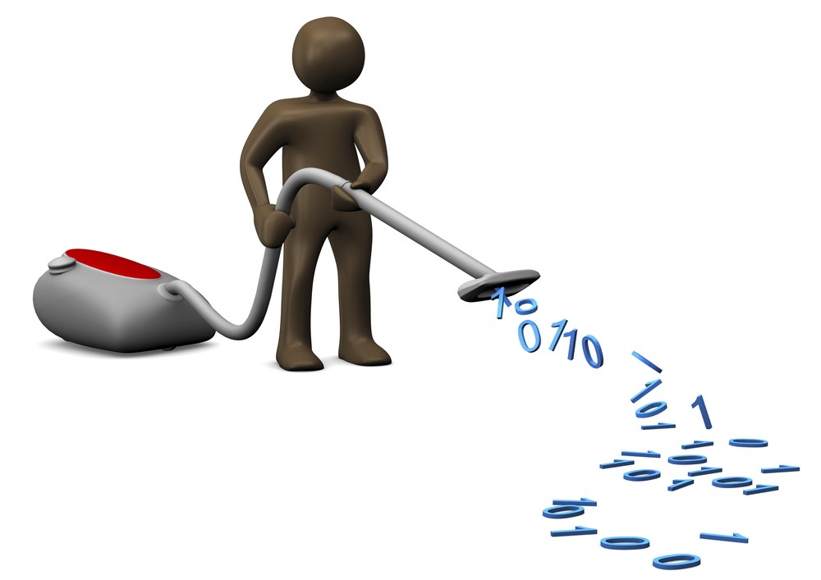
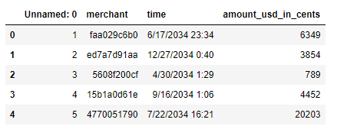
Data Cleaning
Approx. 1M rows of data
13,682 unique merchants
1,923 merchants transacted only once (14%)
Get rid of merchant’s that only transacted once, assume it was a demo
No apparent null values or placeholder values

Slide 4

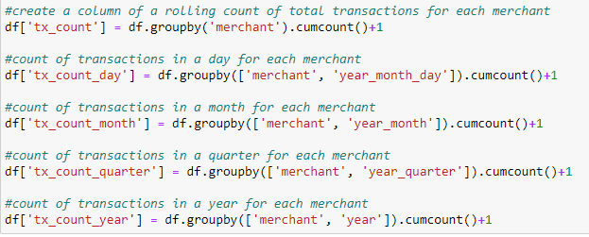
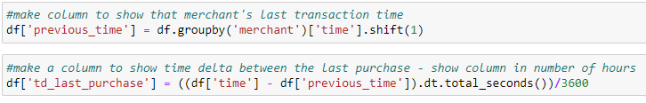
Feature Engineering
Previous time column brings the most recent past transaction time stamp to the current row
Time Delta from last purchase column is subtracting the current time from the previous time stamp

Slide 5
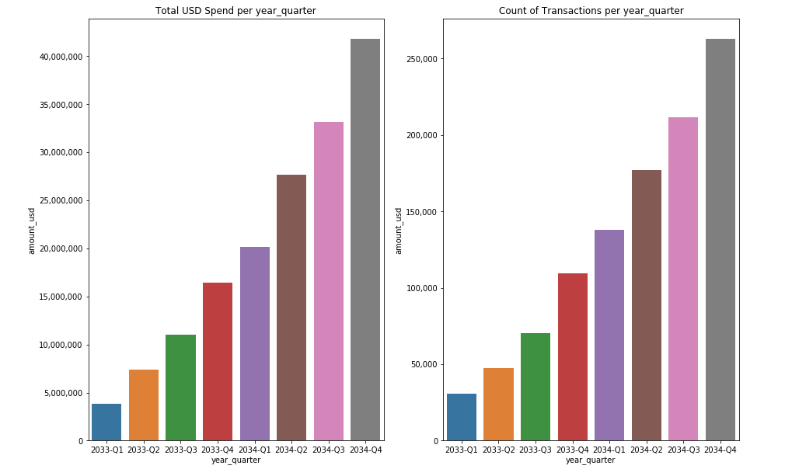
[EDA] When are merchants transacting?
Spend and Frequency increases every Quarter

Slide 6
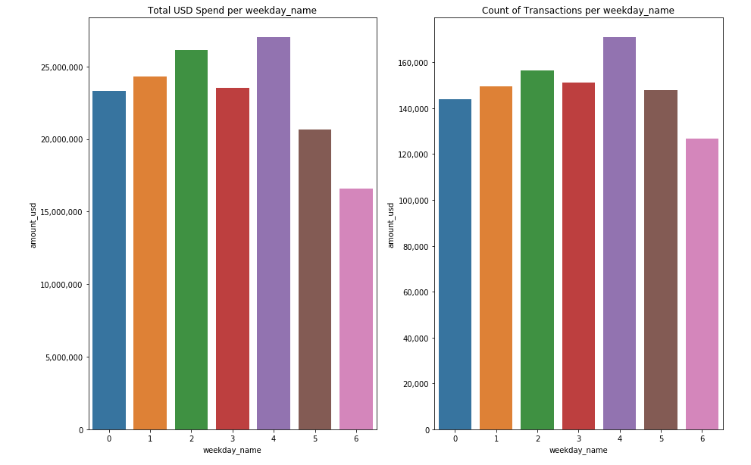
[EDA] Saturday and Sunday – Lower Spend
0 = Monday
6 = Sunday

Slide 7
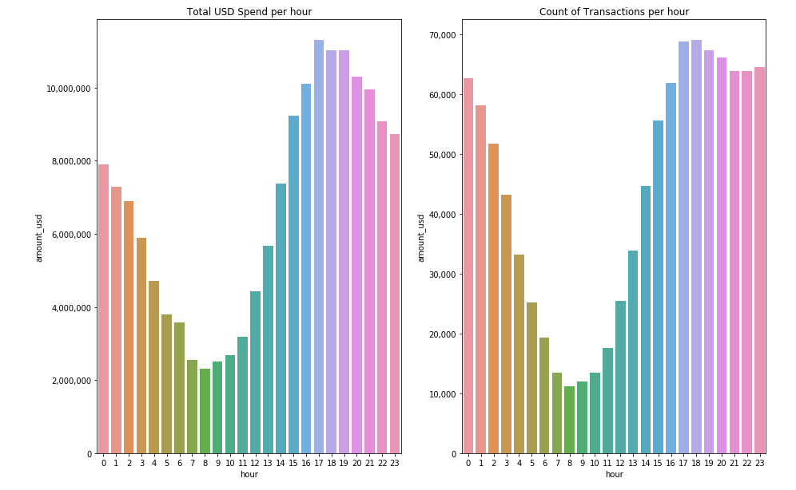
[EDA] Hours 0-3 and 15-23 are high activity

Slide 8
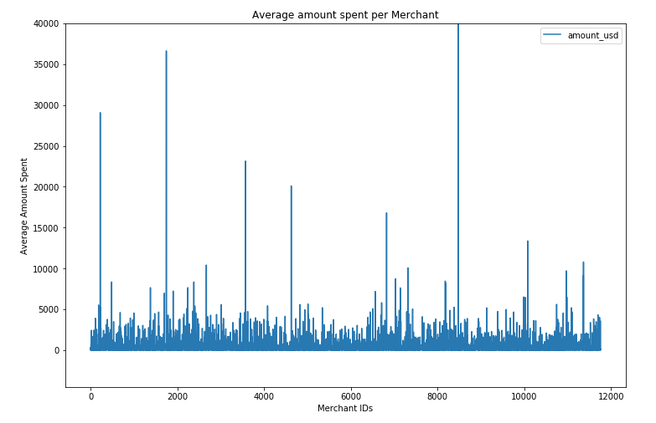
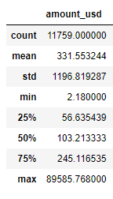
[EDA] Average Spend Amount per Merchant
High standard deviation indicates spend amount may be important to identify merchant type.

Slide 9
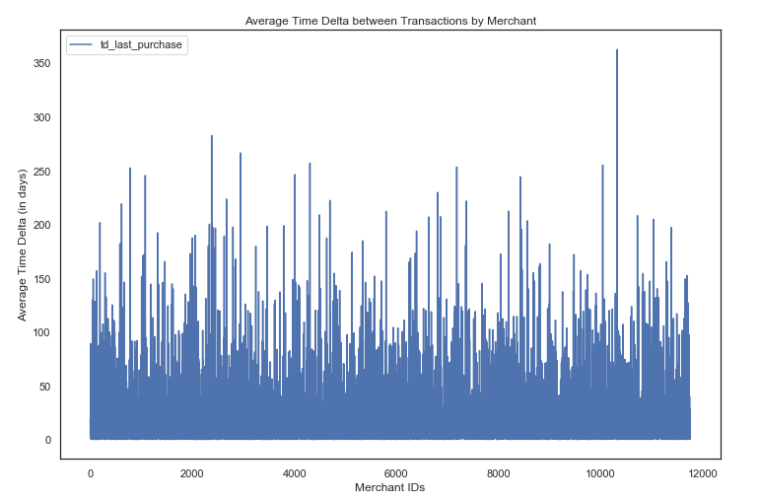
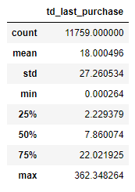
[EDA] Average Time Delta (in Days) per Merchant
High standard deviation indicates time delta between transactions may be important to identify merchant type.

Slide 10
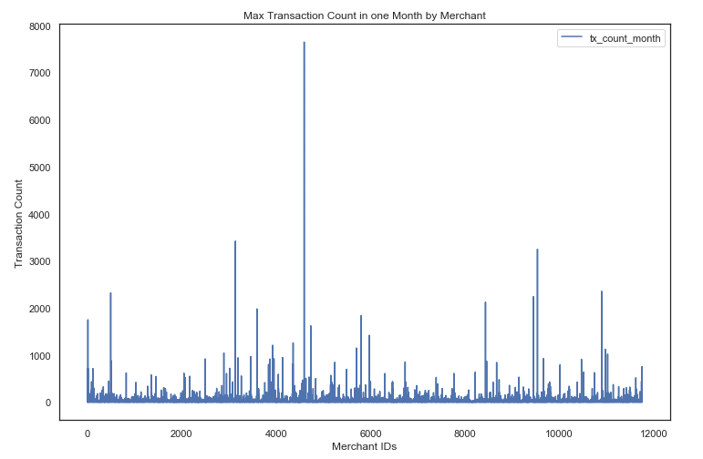
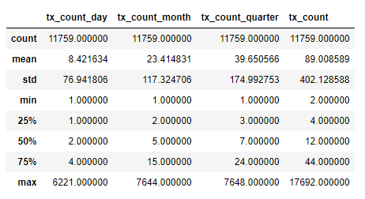
[EDA] Transaction Frequency per Merchant
High standard deviation indicates transaction frequency may be important to identify merchant type.

Slide 11
Final Feature Selection
All Features were grouped by Merchant:
Average amount spent
Average time delta
Max transaction count in one day
Max transaction count in one month
Transaction count for each quarter
Transaction count in “active hours”
Transaction count Weekday vs Weekend

Slide 12
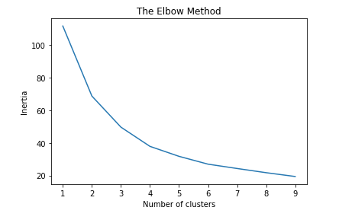
K-Means Clustering Model
Merchant type is unlabeled – Unsupervised learning
How many clusters should we have?
4 or 5 Clusters is where the inertia levels off

Slide 13




Cluster Assignments
Cluster 0: Ecommerce/Retail:
Relatively frequent medium sized transactions, seasonal: Amazon, Target
Cluster 1: B2B:
Pays monthly/bimonthly/quarterly in largest amounts: Salesforce, Shopify
Cluster 2: SaaS:
Pays biweekly/monthly in larger amounts: Docusign, Tableau, Splunk
Cluster 3: B2C:
Frequent small transactions: Lyft, Doordash

Slide 14
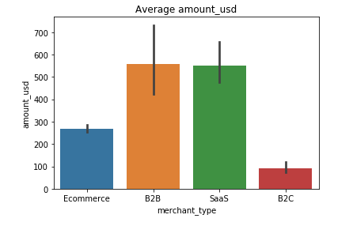
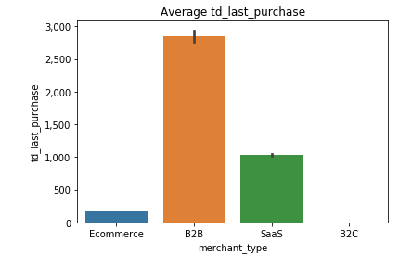
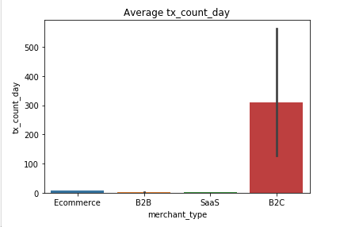
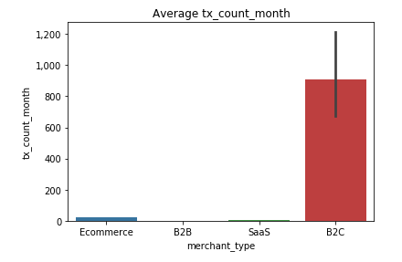
Features by Merchant Type Clusters

Slide 15
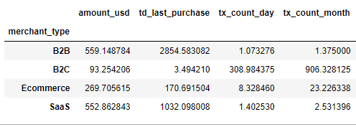
Model Results
Feature averages across Merchant Type clusters:
Merchant Type Count:
E-commerce : 9,097
SaaS: 2,134
B2B: 464
B2C: 64
Other Conclusions:
Features - Average spend, time delta, and transaction count features have significant variance across clusters
Inertia = 37.86: sum of squared error for each cluster. The smaller the inertia the denser the cluster. Too far from zero
Curse of dimensionality – too many features for k-means
Better datetime feature engineering
More model tuning

Slide 16
Question 2:
Churn

Slide 17
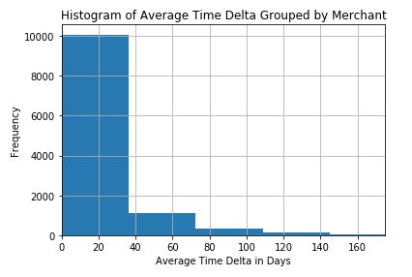
2a. - Concrete Definition for Churn
Average Time Delta = 18 days
97% of merchants have an average time delta of 90 days or less
Definition of churn = 90 days

Slide 18
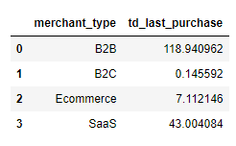
2a. - Ideal Churn Definition
Average Time Delta by Merchant Group:
Each Merchant type has different customers – churn would be defined differently for each merchant type
With additional time, would make 4 separate definitions with 4 separate models

Slide 19
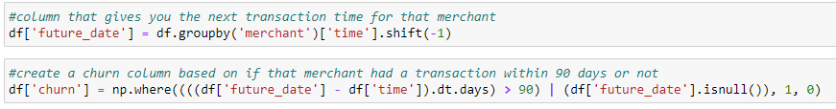
2b. - Which Merchants Already Churned?
Churn Feature Engineering
Future_date column brings the most recent future transaction time stamp to the current row
Churn column is based on time delta > 90 days OR a null value, meaning there is no future transaction

Slide 20
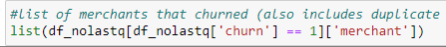
2b. - Which Merchants Already Churned?
8822 events of churn from Q1 2033 to Q3 2034
Not using Q4 2034 because you don’t know if that’s a churn
6739 unique merchants churned
65% of unique merchants churned at least once
17% of merchants churned multiple times

Slide 21

2c. - Model to Predict Future Churn

Slide 22
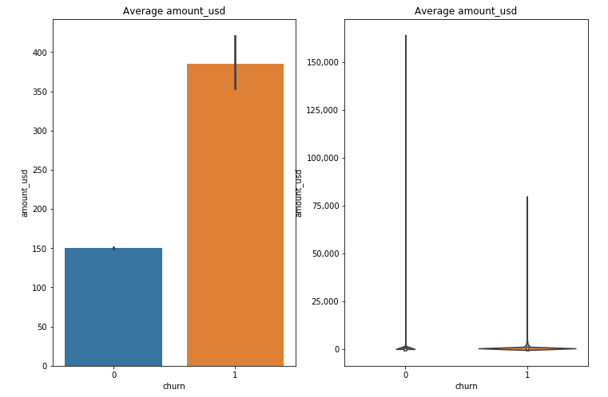
2c. - [EDA] Average Amount spent

Slide 23
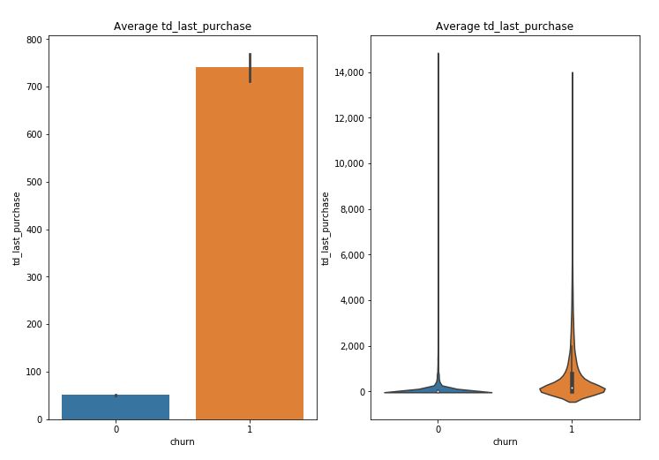
2c. - [EDA] Average Time Delta (in hours)

Slide 24
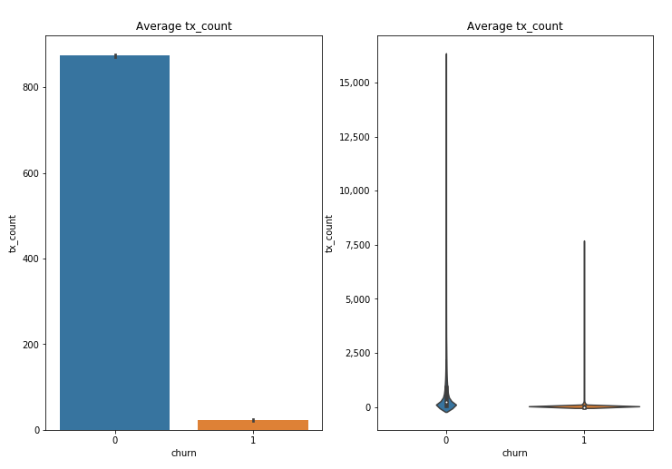
2c. - [EDA] Average Transaction Count

Slide 25
2c. - [EDA] Average Transaction Count

Slide 26
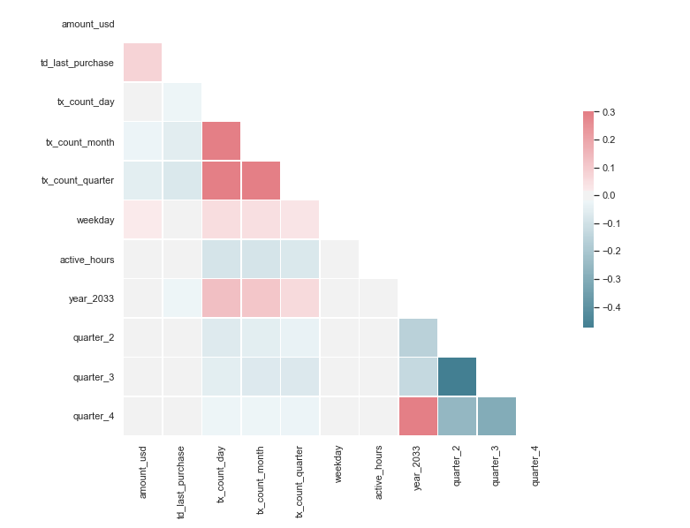
2c. – Feature Correlation and PCA
Variance Explained by:
3 features = 92.8%
4 features = 98.9%
5 features = 99.9%

Slide 27
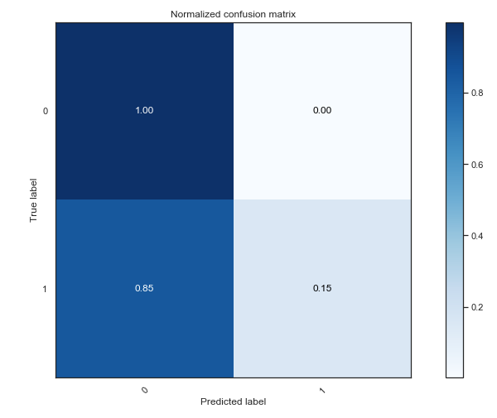
2c. – Model Selection: Random Forest
Final Model Accuracy = 98%
HOOOORAAAYYYYY!!!.....oh wait no
Only 2.1% of the data is a churn
Unbalanced data issue
Model is overfitting
Trouble predicting Churn group

Slide 28
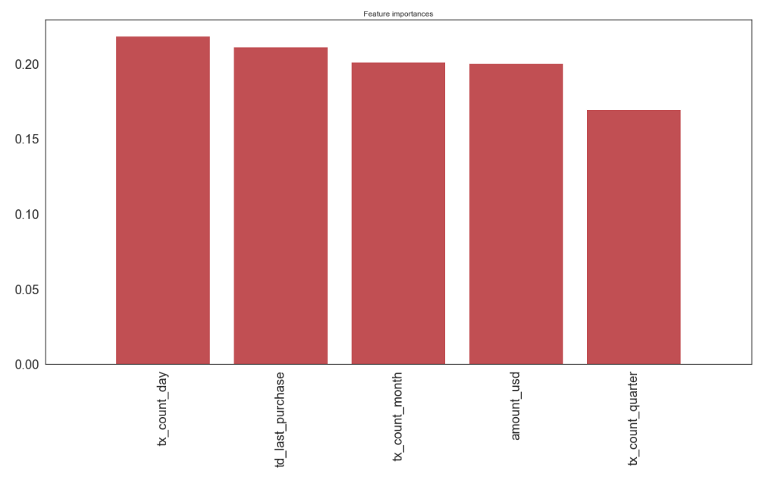
2c. – Feature Importance

Slide 29
2c. – Conclusions
Features are good predictors for churn based on EDA.
The model is severely overfitting due to unbalanced churn vs no-churn groups. If given more time I would use techniques such as "over-sampling" or "under-sampling" to balance out the churn groups and build a more useful model.
Parameter tuning improved precision of the churn group from 50% to 59% but the recall and f1-score didn't improve.
I would also try an XG Boost model to see if that improved results at all.

